Slide 1

Artificial Intelligence Intro and Agents
CS 444 – Spring 2021
Dr. Kevin Molloy
Department of Computer Science
James Madison University
Some figures and inspiration from
Zoran Duric, Amarda Shehu, Dan Klein, and Pieter Abbeel

Slide 2

Meet and Greet
Who is this person?
Grew up in Newport News. Last 20 years in Northern Virginia
Got my PhD in 2015 in computer science with a focus on robotics, artificial intelligence and structural biology (proteins)
Work/lived in southern France (Toulouse) for ≈ 2 years as a research scientist
My 3rd year at JMU

Slide 3
Course Information
Communication
Announcements on webpage and Canvas
Questions? Discussion on Piazza
Email: molloykp@jmu.edu
Office hours are posted on Canvas.
Course Delivery:
Lectures: zoom (see canvas for link)
Review of homework via Youtube channel
Autograded homework and projects via https://autolab.cs.jmu.edu
Course Assignment and Topics
Class calendar is available at https://w3.cs.jmu.edu/molloykp/cs444/cs444_2021Spring/cs444_Calendar.php
All due dates are in Canvas
Programming Assignments PAs
Between 6 and 8
Python Programming Language
Students will be expected to present their findings/results to the class (at least once in the semester). This may be done live or via video.
PA 0 due next Tuesday

Slide 4
Mastery Learning Model
Quiz each week on material
If you score well, your done.
If you are not happy with your score, you can take another quiz on the subject the following week.
Starting around week 5 or 6, the quiz will consist of the current material plus material from 5 or 6 weeks ago.
Approximately 12 of these quizzes. No exams.
Instruction
(Unit x)
Assessment
Quiz
Content
Mastered
Instruction
(Unit x + 1)
Additional Material and
Instruction
Assessment
Quiz #2

Slide 5
Course Information
Prerequisites:
We will be using some basic statistics and linear algebra. Review material will be provided.
We will use a little calculus in this book for analysis.
Textbook:
Artificial Intelligence, Forth Edition by Stuart Russell and Peter Norvig
The lecture slides and other reading material will be posted.
Grading
Task | Number | Percent
Weekly Quizzes | 12 | 50%
Programming Assignments | 6 to 8 | 35%
Homework, Labs, Participation | 6 to 8 | 15%

Slide 6
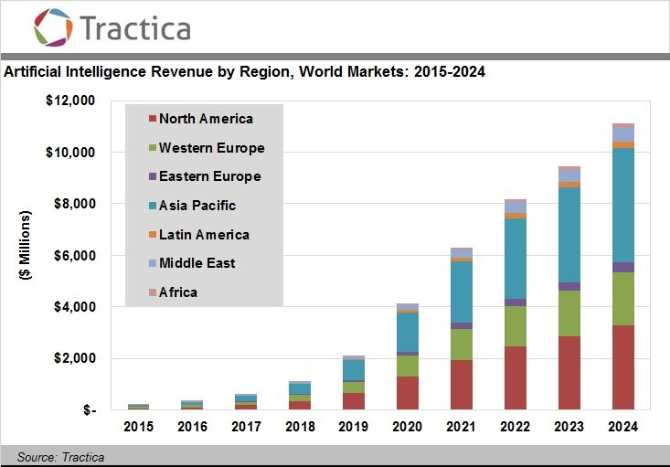
Why Take This Class?
You want to learn more about AI
You want to get an exciting job
CS 445 Machine Learning
JMU AI and Machine Learning Seminar Series
Third Thursday of Each Month (4:15 – 5:00 pm)

Slide 7
Important This Week
Register on Autolab (https://autolab.cs.jmu.edu). You will need to the use VPN if connecting to Autolab from off Campus (VPN instructions are on the resources page on the class web site).
Signup on Piazza.
PA 0 is out and due next Tuesday, January 26th.
Quiz 0 will be published on Canvas after class on Thursday and will be due Friday, January 22nd @ 5:00 pm. The quiz will be timed (20 minutes to complete once started). Topics for Quiz 0 are posted on the class website.

Slide 8
Objectives For Today
What is AI?
What can AI do?
What are we going to do in this course?
Introduction to AI agents

Slide 9
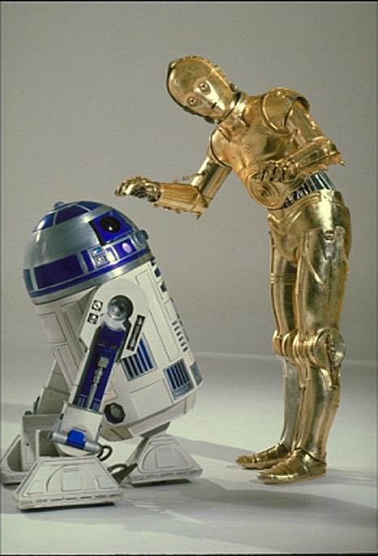
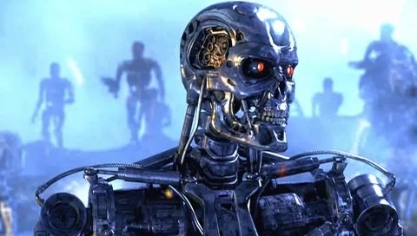
What is AI?
Sci-Fi tells us AI:
can be nice (R2D2, C3PO)
can be scary (terminator)
I am reading this book now, and so far, it is good.

Slide 10
What is Intelligence?
Are we intelligent? Are animals intelligent?
Take a few moments and write down your definition of intelligence

Slide 11
My definition
A computational model/process that:
solve a problem that does not have an efficient algorithm and requires ”intuition”
Reasons using facts (and allows new facts to be learned)
Learns a process by given a set of examples (this is a specialty of AI known as machine learning or statistical inference).

Slide 12
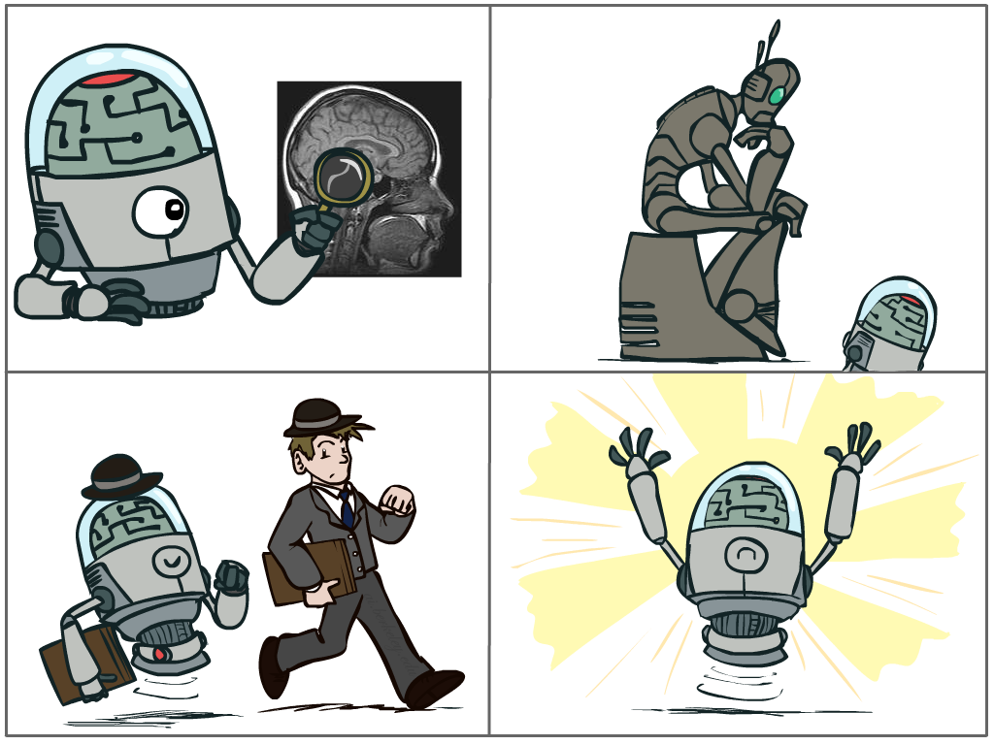
What is AI?
Science of making machines that:
Think like people
Think rationally
Act like people
Act rationally

Slide 13
What is AI?
Science of making machines that:
Think like people
Think rationally
Act like people
Act rationally

Slide 14
Rational Decisions? What are these?
We use the term rational in a very specific, technical way:
Rational: maximally achieving pre-defined goals
Rationality only concerns what decisions are made (not the thought process behind how the decisions are made)
Goals are expressed in terms of the utility of outcomes
Being rational means maximizing your expected utility
Might think of AI as being the study of computational rationality¹
¹ term from Peter Abbeel

Slide 15
Quantifying Artificial Intelligence – The Turing Test
To be intelligent is to act humanly. – Alan Turing
Turing Test
Turing focused on “acting like a human” as an operational definition of artificial intelligence: Turing (1950). “Computing machinery and intelligence”
Proposed the “imitation” game as a test for a hidden intelligent artifact who could be fed visual and material information
Objective: fool a human 30% of the time in a 5-minute test
This test introduced major components of AI: knowledge, reasoning, language, understanding, learning (computer vision, robotics). Turing predicted this would be reached by the year 2000.
Problem: Turing test is not reproducible, informative/constructive, or amenable to mathematic analysis.
Weak vs Strong AI argument: One can simulate intelligence but not possess it.

Slide 16
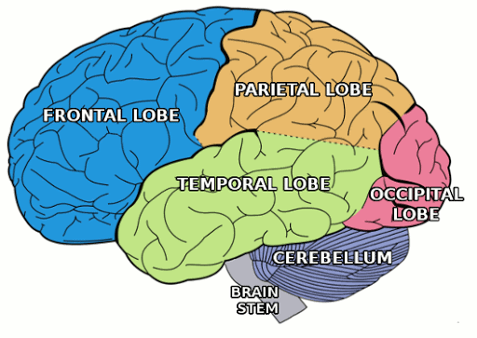
Our Brains
Human brains are very good at making rational decisions, but not perfect
Brains are not as modular as software, so hard to reverse engineer
"Brains are to intelligence as wings are to flight"
 | Supercomputer | Personal Computer | Fly | Human Brain
Computational Units | 10⁶ GPUs and CPUs 10¹⁵ transistors | 8 CPU cores 10¹⁰ transistors | 10⁵ neurons | 10⁶ columns 10¹¹ neurons
Storage Units | 10¹⁶ bytes RAM 10¹⁷ bytes disk | 10¹⁰ bytes RAM 10¹² bytes disk | 10⁷ synapses | 10¹¹ neurons 10¹⁴ synapses
Cycle time | 10⁻⁹ secs | 10⁻⁹ secs | 10⁻³ secs | 10⁻³ secs
Operations/sec | 10¹⁸ | 10¹⁰ | 10¹⁰ | 10¹⁷
If each synapse is 1 FLOP (fire/not fire once per second),
Then human brain requires 10¹⁵ flops = 1 petaflop
100,000 CPUs
Amazon EC2 costs $5,000 per hour

Slide 17
Summarized History of AI
1940-1950: Early days
1943: McCulloch & Pitts: Boolean circuit model of brain
1950: Turing's “Computing Machinery and Intelligence”
1950—70: Excitement: Look, Ma, no hands!
1950s: Early AI programs, including Samuel's checkers program, Newell & Simon's Logic Theorist, Gelernter's Geometry Engine
1956: Dartmouth meeting: “Artificial Intelligence” adopted
1965: Robinson's complete algorithm for logical reasoning
1970—90: Knowledge-based approaches
1969—79: Early development of knowledge-based systems
1980—88: Expert systems industry booms
1988—93: Expert systems industry busts: “AI Winter”
1990—: Statistical approaches
Resurgence of probability, focus on uncertainty
General increase in technical depth
Agents and learning systems… “AI Spring”?
2021—: Where are we now?

Slide 18
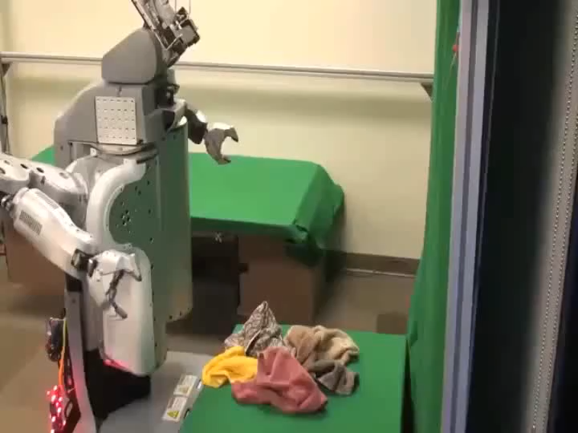

What Can AI Do?
Quiz: Which of the following can be done at present?
Play a decent game of Jeopardy?
Play a decent game of table tennis?
Drive safely along a curving mountain road?
Drive safely along Reservoir Street?
Buy a week's worth of groceries on the web?
Buy a week's worth of groceries at Martins
Discover and prove a new mathematical theorem?
Converse successfully with another person for an hour?
Perform a surgical operation?
Put away the dishes and fold the laundry?
Translate spoken Chinese into spoken English in real time?
Write an intentionally funny story?

Slide 19
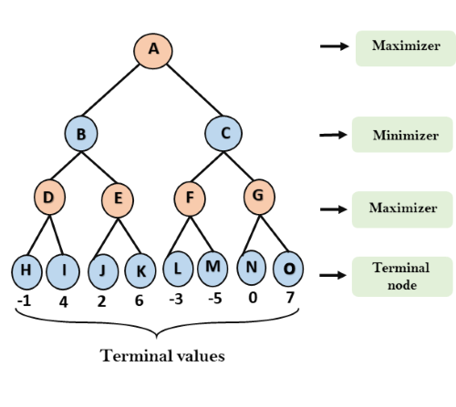
Course Topics
Part I: Making decisions
Fast search and planning
Constraint satisfaction
Adversarial and Uncertain search
Part II: Representing Knowledge and Logic
Propositional Logic and representation
First-order logic and reasoning
Part III: Reasoning under Uncertainty
Markov Models
Bayes nets

Slide 20
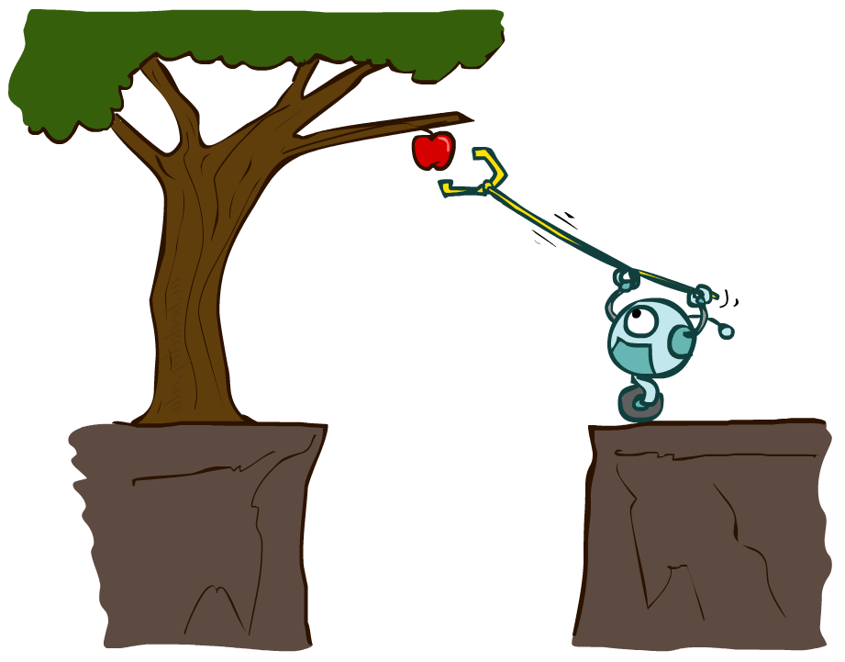
Designing Rational Agents
An agent is an entity that perceives and acts.
A rational agent selects actions that maximize its (expected) utility given the percepts sequence to date.
Characteristics of the percepts, environment, and action space dictate techniques for selecting rational actions (PEAS)
This course is about:
General AI techniques for a variety of problem types
Learning to recognize when and how a new problem can be solved with an existing technique
Sensors
Agent
Percepts
Environment
?
Actuators
Actions
Rational ≠ omniscient
Percepts may not supply all relevant information
Rational ≠ clairvoyant
Action outcomes may not be as expected
Hence, rational does not always equal successful.

Slide 21
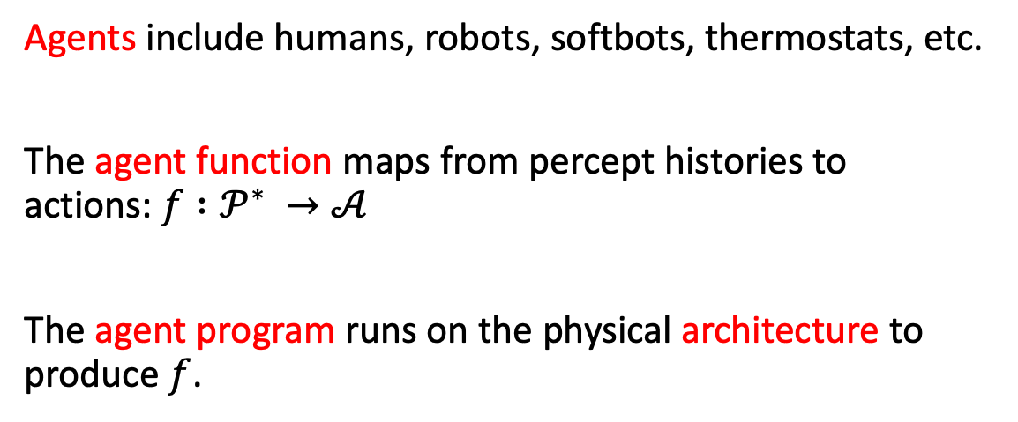
Agents and Environments
Agents include humans, robots, softbots, thermostats, etc.
The agent function maps from percept histories to actions:$f :𝒫^{∗} →𝒜$
The agent program runs on the physical architecture to produce $f$.

Slide 22
Environment Types
Do the agent’s sensors give complete information (relevant to the choice of action) about the estate of the environment at each point in time?
Fully vs. partially-observable
Does the agent operate in an environment with other agents?
Single vs. multi-agent (competitive, cooperative)
Is the next state of the environment complete determined by the current state and agent action?
Episodic vs. sequential
Can the environment change while the agent is deliberating?
Static vs dynamic
What is the domain of values for variables racking environment state, agent state, and time?
Discrete vs. continuous
Does the agent know outcomes of all its actions?
Known vs unknown

Slide 23
Vacuum-cleaner World and Agent Types
Four basic types of agents:
Simple reflex agents
Reflex agents w/state
Goal-based agents
Utility-based agents
Percepts: location and contents, e.g., [A, Dirty]
Action: Left, Right, Suck (remove the dirt) , NoOp
A simple reflex agent

Slide 24
Reflex Agent Example
function REFLEX-VACUUM-AGENT ([location, status]) returns an action
if status = Dirty then return Suck
else if location = A then return Right
else if location = B then return Left
Can a reflex agent be rational?
A rational agent:
chooses which ever action maximizes the expected value of the performance measure given the percept sequence to date.
Depends, on the performance measure:
1 pt for each clean square in each time step
Geography is known a priori
Agent correctly perceives its location and dirt, and the cleaning mechanism works 100% of the time.

Slide 25
Learning-based agents
Learning-based agents:
Performance elements was the "entire" agent previously (accepted sensor input and commanded the actuators).
Learning elements gets feedback from the critic and changes the performance element.
Problem generator is the "lets try this and see what happens". Let's explore the impact of other actions.
Deepmind's AlphaGo and other recent breakthroughs use these types of agents.

Slide 26
Important This Week
Register on Autolab (https://autolab.cs.jmu.edu). You will need to the use VPN if connecting to Autolab from off Campus (VPN instructions are on the resources page on the class web site).
Signup on Piazza.
PA 0 is out and due next Tuesday, January 26th. HW 0 is due this Thursday (January 21st).
Quiz 0 will be published on Canvas after class on Thursday and will be due Friday, January 22nd @ 5:00 pm. The quiz will be timed (20 minutes to complete once started). Topics for Quiz 0 are posted on the class website.

